Slide 1

Networks & Security Lecture-4
www.corvit.com

Slide 2
Topics
Network Layer
Router Architecture
IP
Subnets
DHCP
NAT
IPv6
SDN
www.corvit.com

Slide 3
















Network Layer
transport segment from sending to receiving host
on sending side encapsulates segments into datagrams
on receiving side, delivers segments to transport layer
network layer protocols in every host, router
router examines header fields in all IP datagrams passing through it
application
transport
network
data link
physical
network
data link
physical
network
data link
physical
network
data link
physical
network
data link
physical
network
data link
physical
network
data link
physical
network
data link
physical
network
data link
physical
network
data link
physical
application
transport
network
data link
physical
network
data link
physical
network
data link
physical
www.corvit.com

Slide 4
Two Key Network-Layer Functions
network-layer functions:
forwarding: move packets from router’s input to appropriate router output
routing: determine route taken by packets from source to destination
routing algorithms
analogy: taking a trip
forwarding: process of getting through single interchange
routing: process of planning trip from source to destination
www.corvit.com

Slide 5
Network Layer: Data Plane, Control Plane
Control Plane
network-wide logic
determines how datagram is routed among routers along end-end path from source host to destination host
two control-plane approaches:
traditional routing algorithms: implemented in routers
software-defined networking (SDN): implemented in (remote) servers
Data Plane
local, per-router function
determines how datagram arriving on router input port is forwarded to router output port
forwarding function
values in arriving
packet header
0111
1
3
2
www.corvit.com

Slide 6

Per-Router Control Plane
Individual routing algorithm components in each and every router interact in the control plane
Routing
Algorithm
control
plane
data
plane
values in arriving
packet header
0111
1
3
2
www.corvit.com

Slide 7
Logically Centralized Control Plane
A distinct (typically remote) controller interacts with local control agents (CAs)
Remote Controller
control
plane
data
plane
CA
CA
CA
CA
CA
values in arriving
packet header
0111
1
3
2
www.corvit.com

Slide 8
Router Architecture Overview
high-level view of generic router architecture:
routing, management
control plane (software)
operates in millisecond
time frame
routing
processor
forwarding data plane (hardware) operttes in nanosecond timeframe
high-seed
switching
fabric
router input ports
router output ports
www.corvit.com

Slide 9
Input Port Functions
lookup,
forwarding
queueing
line
termination
link
layer
protocol
(receive)
switch
fabric
physical layer:
bit-level reception
data link layer:
e.g., Ethernet
see chapter 5
decentralized switching:
using header field values, lookup output port using forwarding table in input port memory (“match plus action”)
goal: complete input port processing at ‘line speed’
queuing: if datagrams arrive faster than forwarding rate into switch fabric
www.corvit.com

Slide 10
Input Port Functions
lookup,
forwarding
queueing
line
termination
link
layer
protocol
(receive)
switch
fabric
physical layer:
bit-level reception
decentralized switching:
using header field values, lookup output port using forwarding table in input port memory (“match plus action”)
destination-based forwarding: forward based only on destination IP address (traditional)
generalized forwarding: forward based on any set of header field values
data link layer:
e.g., Ethernet
see chapter 5
www.corvit.com

Slide 11
Destination-Based Forwarding
forwarding table
Destination Address Range
11001000 00010111 00010000 00000000
through
11001000 00010111 00010111 11111111
11001000 00010111 00011000 00000000
through
11001000 00010111 00011000 11111111
11001000 00010111 00011001 00000000
through
11001000 00010111 00011111 11111111
otherwise
Link Interface
0
1
2
3
Q: but what happens if ranges don’t divide up so nicely?
www.corvit.com

Slide 12
Longest Prefix Matching
longest prefix matching
when looking for forwarding table entry for given destination address, use longest address prefix that matches destination address.
Destination Address Range
11001000 00010111 00010*** *********
11001000 00010111 00011000 *********
11001000 00010111 00011*** *********
otherwise
Link interface
0
1
2
3
examples:
DA: 11001000 00010111 00010110 10100001
which interface?
DA: 11001000 00010111 00011000 10101010
which interface?
www.corvit.com

Slide 13
The Internet Network Layer
host, router network layer functions:
transport layer: TCP, UDP
routing protocols
path selection
RIP, OSPF, BGP
IP protocol
addressing conventions
datagram format
packet handling conventions
network
layer
forwarding
table
ICMP protocol
error reporting
router “signaling”
link layer
physical layer
www.corvit.com

Slide 14
IP Datagram Format
IP protocol version
number
32 bits
total datagram
length (bytes)
header length
(bytes)
head.
len
type of
service
ver
length
for
fragmentation/
reassembly
“type” of data
flgs
fragment
offset
16-bit identifier
max number
remaining hops
(decremented at
each router)
time to
live
upper
layer
header
checksum
32 bit source IP address
upper layer protocol
to deliver payload to
32 bit destination IP address
options (if any)
e.g. timestamp,
record route
taken, specify
list of routers
to visit.
data
(variable length,
typically a TCP
or UDP segment)
how much overhead?
20 bytes of TCP
20 bytes of IP
= 40 bytes + app layer overhead
www.corvit.com

Slide 15

IP Addressing: Introduction
IP address: 32-bit identifier for host, router interface
interface: connection between host/router and physical link
router’s typically have multiple interfaces
host typically has one or two interfaces (e.g., wired Ethernet, wireless 802.11)
IP addresses associated with each interface
223.1.1.1
223.1.2.1
223.1.1.2
223.1.1.4
223.1.2.9
223.1.1.3
223.1.3.27
223.1.2.2
223.1.3.1
223.1.3.2
223.1.1.1 = 11011111 00000001 00000001 00000001
223
1
1
1
www.corvit.com

Slide 16
IP address and subnet mask
192.168.10.1 IP address
255.255.255.0 Subnet Mask 8 bits
Subnet mask identify the network and host portions of the IP address.
Binary 1(one) means Network
Binary 0 (zero) means Host
255 . 255 . 254 .0
11111111.11111111.11111110.00000000 9 bits 2’9 =512
172.168.10.1
255.255.0.0 16 bits 65536
10.0.0.1
255.0.0.0 24 bits available for host addresses
www.corvit.com

Slide 17
IP Addressing: CIDR
CIDR: Classless InterDomain Routing
subnet portion of address of arbitrary length
address format: a.b.c.d/x, where x is # bits in subnet portion of address
subnet
part
host
part
11001000 00010111 00010000 00000000
200.23.16.0/23
www.corvit.com

Slide 18
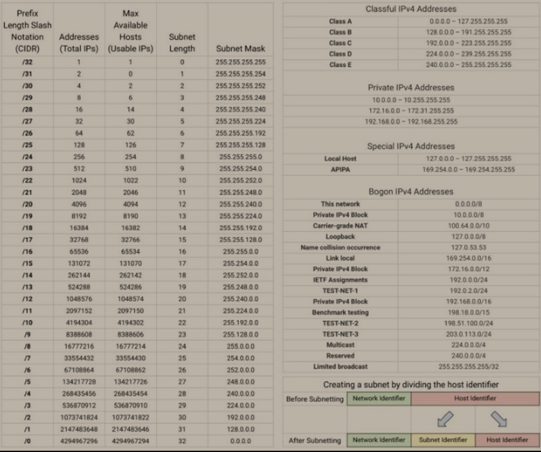
Subneting
www.corvit.com

Slide 19
Subnets
IP address:
subnet part - high order bits
host part - low order bits
what’s a subnet ?
device interfaces with same subnet part of IP address
can physically reach each other without intervening router
223.1.1.1
223.1.1.2
223.1.2.1
223.1.1.4
223.1.2.9
223.1.2.2
223.1.1.3
223.1.3.27
subnet
223.1.3.1
223.1.3.2
network consisting of 3 subnets
www.corvit.com

Slide 20
Subnets
223.1.1.0/24
223.1.2.0/24
recipe
to determine the subnets, detach each interface from its host or router, creating islands of isolated networks
each isolated network is called a subnet
223.1.1.1
223.1.1.2
223.1.2.1
223.1.1.4
223.1.2.9
223.1.2.2
223.1.1.3
223.1.3.27
subnet
223.1.3.1
223.1.3.2
223.1.3.0/24
subnet mask: /24
www.corvit.com

Slide 21
Subnets
223.1.1.2
223.1.1.1
223.1.1.4
how many?
223.1.1.3
223.1.9.2
223.1.7.0
223.1.9.1
223.1.7.1
223.1.8.1
223.1.8.0
223.1.2.6
223.1.3.27
223.1.2.1
223.1.2.2
223.1.3.1
223.1.3.2
www.corvit.com

Slide 22
DHCP: Dynamic Host Configuration Protocol
goal: allow host to dynamically obtain its IP address from network server when it joins network
can renew its lease on address in use
allows reuse of addresses (only hold address while connected/“on”)
support for mobile users who want to join network (more shortly)
DHCP overview:
host broadcasts “DHCP discover” msg [optional]
DHCP server responds with “DHCP offer” msg [optional]
host requests IP address: “DHCP request” msg
DHCP server sends address: “DHCP ack” msg
www.corvit.com

Slide 23


DHCP Client-Server Scenario
DHCP
server
223.1.1.0/24
223.1.1.1
223.1.2.1
223.1.1.2
arriving DHCP
client needs
address in this
network
223.1.1.4
223.1.2.9
223.1.3.27
223.1.2.2
223.1.1.3
223.1.2.0/24
223.1.3.1
223.1.3.2
223.1.3.0/24
www.corvit.com

Slide 24
DHCP Client-Server Scenario
DHCP server: 223.1.2.5
DHCP discover
arriving
client
src : 0.0.0.0, 68
dest.: 255.255.255.255,67
yiaddr: 0.0.0.0
transaction ID: 654
Broadcast: is there a DHCP server out there?
DHCP offer
src: 223.1.2.5, 67
dest: 255.255.255.255, 68
yiaddrr: 223.1.2.4
transaction ID: 654
lifetime: 3600 secs
Broadcast: I’m a DHCP server! Here’s an IP address you can use
DHCP request
src: 0.0.0.0, 68
dest:: 255.255.255.255, 67
yiaddrr: 223.1.2.4
transaction ID: 655
lifetime: 3600 secs
Broadcast: OK. I’ll take that IP address!
DHCP ACK
src: 223.1.2.5, 67
dest: 255.255.255.255, 68
yiaddrr: 223.1.2.4
transaction ID: 655
lifetime: 3600 secs
Broadcast: OK. You’ve got that IP address!
www.corvit.com

Slide 25
DHCP: More Than IP Addresses
DHCP can return more than just allocated IP address on subnet:
address of first-hop router for client
name and IP address of DNS sever
network mask (indicating network versus host portion of address)
www.corvit.com

Slide 26


DHCP: Example
DHCP
UDP
IP
Eth
Phy
connecting laptop needs its IP address, addr of first-hop router, addr of DNS server: use DHCP
DHCP
DHCP
DHCP
DHCP
DHCP request encapsulated in UDP, encapsulated in IP, encapsulated in 802.1 Ethernet
DHCP
DHCP
DHCP
UDP
IP
Eth
Phy
168.1.1.1
DHCP
DHCP
DHCP
Ethernet frame broadcast (dest: FFFFFFFFFFFF) on LAN, received at router running DHCP server
DHCP
router with DHCP
server built into
router
Ethernet demuxed to IP demuxed, UDP demuxed to DHCP
www.corvit.com

Slide 27
DHCP: Example
DHCP
UDP
IP
Eth
Phy
DCP server formulates DHCP ACK containing client’s IP address, IP address of first-hop router for client, name & IP address of DNS server
DHCP
DHCP
DHCP
DHCP
encapsulation of DHCP server, frame forwarded to client, demuxing up to DHCP at client
DHCP
DHCP
UDP
IP
Eth
Phy
DHCP
DHCP
DHCP
router with DHCP
server built into
router
client now knows its IP address, name and IP address of DNS server, IP address of its first-hop router
DHCP
www.corvit.com

Slide 28
NAT: Network Address Translation
rest of
Internet
local network
(e.g., home network)
10.0.0/24
10.0.0.1
10.0.0.4
10.0.0.2
138.76.29.7
10.0.0.3
all datagrams leaving local
network have same single source NAT IP address: 138.76.29.7,different source port numbers
datagrams with source or
destination in this network
have 10.0.0/24 address for
source, destination (as usual)
www.corvit.com

Slide 29
NAT: Network Address Translation
motivation: local network uses just one IP address as far as outside world is concerned:
range of addresses not needed from ISP: just one IP address for all devices
can change addresses of devices in local network without notifying outside world
can change ISP without changing addresses of devices in local network
devices inside local net not explicitly addressable, visible by outside world (a security plus)
www.corvit.com

Slide 30
NAT: Network Address Translation
implementation: NAT router must:
outgoing datagrams: replace (source IP address, port #) of every outgoing datagram to (NAT IP address, new port #)
. . . remote clients/servers will respond using (NAT IP address, new port #) as destination addr
remember (in NAT translation table) every (source IP address, port #) to (NAT IP address, new port #) translation pair
incoming datagrams: replace (NAT IP address, new port #) in dest fields of every incoming datagram with corresponding (source IP address, port #) stored in NAT table
www.corvit.com

Slide 31
NAT: Network Address Translation
NAT translation table
WAN side addr LAN side addr
2: NAT router
changes datagram
source addr from
10.0.0.1, 3345 to
138.76.29.7, 5001,
updates table
1: host 10.0.0.1
sends datagram to
128.119.40.186, 80
138.76.29.7, 5001 10.0.0.1, 3345
…… ……
S: 10.0.0.1, 3345
D: 128.119.40.186, 80
10.0.0.1
1
2
S: 138.76.29.7, 5001
D: 128.119.40.186, 80
10.0.0.4
10.0.0.2
138.76.29.7
S: 128.119.40.186, 80
D: 10.0.0.1, 3345
4
S: 128.119.40.186, 80
D: 138.76.29.7, 5001
3
10.0.0.3
4: NAT router
changes datagram
dest addr from
138.76.29.7, 5001 to 10.0.0.1, 3345
3: reply arrives
dest. address:
138.76.29.7, 5001
* Check out the online interactive exercises for more examples: http://gaia.cs.umass.edu/kurose_ross/interactive/
www.corvit.com

Slide 32
IPv6: Motivation
initial motivation: 32-bit address space soon to be completely allocated.
additional motivation:
header format helps speed processing/forwarding
header changes to facilitate QoS
IPv6 datagram format:
fixed-length 40 byte header
no fragmentation allowed
www.corvit.com

Slide 33
IPv6 Datagram Format
priority: identify priority among datagrams in flow
flow Label: identify datagrams in same “flow.”
(concept of“flow” not well defined).
next header: identify upper layer protocol for data
ver
pri
flow label
payload len
next hdr
hop limit
source address
(128 bits)
destination address
(128 bits)
data
32 bits
www.corvit.com

Slide 34
Other Changes From IPv4
checksum: removed entirely to reduce processing time at each hop
options: allowed, but outside of header, indicated by “Next Header” field
ICMPv6: new version of ICMP
additional message types, e.g. “Packet Too Big”
multicast group management functions
www.corvit.com

Slide 35
Transition From IPv4 To IPv6
not all routers can be upgraded simultaneously
no “flag days”
how will network operate with mixed IPv4 and IPv6 routers?
tunneling: IPv6 datagram carried as payload in IPv4 datagram among IPv4 routers
IPv4 header fields
IPv6 header fields
IPv4 payload
IPv4 source, dest addr
IPv6 source dest addr
UDP/TCP payload
IPv6 datagram
IPv4 datagram
www.corvit.com

Slide 36
Tunneling
A
B
IPv4 tunnel
connecting IPv6 routers
E
F
logical view:
IPv6
IPv6
IPv6
IPv6
A
B
C
D
E
F
physical view:
IPv6
IPv6
IPv4
IPv4
IPv6
IPv6
www.corvit.com
www.corvit.com

Slide 37
Tunneling
A
B
IPv4 tunnel
connecting IPv6 routers
E
F
logical view:
IPv6
IPv6
IPv6
IPv6
A
B
C
D
E
F
physical view:
IPv6
IPv6
IPv4
IPv4
IPv6
IPv6
flow: X
src: A
dest: F
data
src:B
dest: E
src:B
dest: E
flow: X
src: A
dest: F
data
Flow: X
Src: A
Dest: F
data
Flow: X
Src: A
Dest: F
data
A-to-B:
IPv6
B-to-C:
IPv6 inside
IPv4
B-to-C:
IPv6 inside
IPv4
E-to-F:
IPv6
www.corvit.com

Slide 38
IPv6: Adoption
Google: 8% of clients access services via IPv6
NIST: 1/3 of all US government domains are IPv6 capable
Long (long!) time for deployment, use
20 years and counting!
think of application-level changes in last 20 years: WWW, Facebook, streaming media, Skype, …
Why?
www.corvit.com

Slide 39
Generalized Forwarding And SDN
Each router contains a flow table that is computed and distributed by a logically centralized routing controller
logically-centralized routing controller
control plane
data plane
local flow table
headers counters actions
1
0100 1101
3
2
values in arriving
packet’s header
www.corvit.com

